Slide 1
Motion Planning
Kaustab Pal

Slide 2
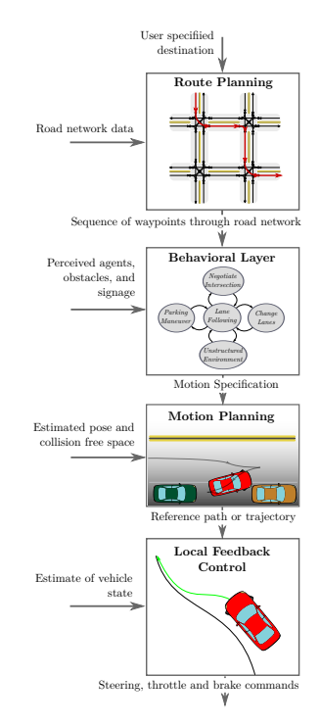
DECISION-MAKING HIERARCHY
Route Planning
Behavioral Decision Making
Motion Planning
Vehicle Control

Slide 3
Graph search algorithms for finding shortest paths
Shortest path algorithms take a graph a starting vertex and a goal vertex as input and returns the shortest way to reach the goal vertex from the start vertex on the graph.
In the real world setting, we can treat different locations as vertices and the roads connecting them as edges between those vertices.
Input: Graph, Start node, End node
Output: Shortest path from start node to end node if path exists

Slide 4
Two important functions used in graph search algos:
g(n) = It is the cost of reaching the current node n from the start node
h(n) = It is a heuristic function that gives us an estimate of the cost of reaching the end node from the current node n.
h(n) <= h*(n),
Here, h*(n) is the actual cost of reaching the end node from the current node n.

Slide 5
For all search functions we will be storing the nodes in a priority queue Q which will be sorted in the increasing order of f(n) for each node.
f(n) = g(n) + h(n)

Slide 6
Basic algo for a search method
Step 1: Initialize empty priority queue.
Step 2: Current node = start node
Step 3: For every adjacent nodes from the start node calculate their respective f values and insert them in the queue.
Step 4: After all the adjacent nodes from the current node is visited, mark the current node as visited.
Step 5: From the Queue pick the node with the minimum f value and set it as the current node.
Step 6: If (current nod != goal node): goto step 3
Step 7: End

Slide 7
Breadth First Search
The most basic graph search method.
Here for every node, g(n) is the same and h(n) = 0.
Since every node has same g(n) their f values are also the same and therefore the priority queue acts as a normal queue, i.e. follows first in first out.
While Breadth First Search will give us the shortest path between the start node and the goal node, sometimes the shortest path might not be the best path. For example, the shortest path between two locations might be through a road which is in very bad condition and might damage your car.
To take this into account, we introduce cost on the edges between two vertices g(n) and the optimal path will have the minimum cost.

Slide 8
Dijkstra’s algorithm
Here for every node, g(n) changes but h(n) = 0.
Every node now has varying g(n), therefore their f values are also varying. The priority queue is sorted in increasing order of the f-values of the node.
Dijkstra’s algorithm gives us the path with the least cost.

Slide 9

Using Breadth First Search or Dijkstra’s Algorithm, the search space expands in all direction. Once we have searched the entire state space, we can easily find the shortest path from the start node to any node. However often times we need to find the shortest path to only one node. In that case Breadth First search and Dijkstra’s algorithm wastes time by searching in all directions.

Slide 10
A* Search Algorithm
It is a directed search algorithm, meaning instead of searching in all directions we search in the direction of the goal thus reducing the search time.
Here for every node, we calculate g(n) and h(n). If h(n) > h*(n), we might not end up with the optimal path to the goal.
The priority queue is sorted in increasing order of the f-values of the nodes.
This gives us the most optimal path to the goal in a short time.

Slide 11
Rapidly Exploring Random Trees (RRT)
Sometimes we are not provided with the graph but just the start and goal location and we have to find a path between these two. Example: Navigating between two points in a parking lot.
To solve this problem we will need to create a graph in the configuration space provided to us and then find the path using that graph.
The problem of creating the graph and navigating the graph aren’t necessarily solved using the same algorithm.
RRT is an algorithm that solves both these problem.

Slide 12
The idea is simple. We start with a graph consisting of only the start node.
We create a node at a random point in the configuration space. If the random node does not lie inside any obstacle. we find a node in the graph which is closest to this node. If the distance between them is <= delta we connect them with an edge. If > delta we create another node along the line connecting the two nodes at a distance delta from the nearest node on the graph. We connect these two nodes with an edge and finally push this node inside the graph.
This is repeated until we reach the goal location.

Slide 13
Root Node

Slide 14
Closest Node
Root Node
New Random Node

Slide 15
Closest Node
Root Node
New Random Node

Slide 16
Root Node

Slide 17
If the nodes are sampled uniformly in RRT, the tree will grow in all directions.
However if we increase the probability of sampling the nodes near the goal state the tree will grow faster towards the goal state.

